Slide 1
AI HACKATHON 2019
STAGE II
Grading of Onion in Real Time
Team Registration ID : AIH19T-0337
Organisation: Plaksha University
Members:
Date: 08th September, 2019
Aman Shah - aman.shah@plaksha.org
Ribhu Lahiri - ribhu.lahiri@plaksha.org
Shikhar Seth - shikhar.seth@plaksha.org
Urvin Soneta - urvin.soneta@plaksha.org
Hemant Menon - hemant.menon@plaksha.org

Slide 2
Table of Contents
Problem Statement - Our Understanding
Proposed solution - Overview
Prior work on this problem
Data Understanding
State of the art
Experimental evaluation

Slide 3
Problem Statement - Our Understanding
<Grading of Onion in Real Time>
Current Situation:
Nearly 16 million tons of onions are produced in India every year, with approximately 400,000 tons exported. It is estimated nearly ~20% is wasted.
Ideal Situation:
The system, if successfully deployed, can reduce around 320,000 tons of onion wastage across the country.The automated grading system not only time saving but also minimizes error.
Issues:
Fruit grading by manual human labour is inefficient, intensive and error prone. From a carton of onions, it is difficult to accurately identify the number of onions that might be defective so that the entire cart is not discarded. The aim is to avoid food wastage, having used the human bias, with the help of machine learning and computer vision.

Slide 4
Proposed Solution - Overview
<Grading of Onion in Real Time>
Given an image of a carton of onions, we need to correctly identify the number of onions that might be defective so that the entire cart is not discarded. The aim is to avoid food wastage, having eliminated the human bias with the help of machine learning and computer vision.
The given data set consists of images of cartons full of onions, labelled with different terms such as ‘double’, ‘onion’, ‘rotten’, ‘smut affected’ etc. A model must be trained to differentiate onions from the sample images. The input will be a high-resolution image of a carton of onions. The output will be the number of defective onions present, along with a recommendation on whether or not to recheck the carton.
Grade | Bulb Size
A | > 80 mm
B | 50-80 mm
C | 30-50 mm
Source:
ICAR - Directorate of Onion and Garlic Research

Slide 5
Prior work on this problem
<Grading of Onion in Real Time>
Convolutional Neural Networks algorithms for image segmentation identified through literature review were:
RCNN ^{[1]}, Faster RCNN ^{[2],} Mask RCNN ^{[3]}
We realised that Unet algorithm (using Reconstruction of deconstructed image for segmentation ^{[4]}) can be used for this stage due to its ability to provide relatively more efficient performance with less data in comparison to the other algorithm identified.
For better performance with more data, we think that Mobilenet algorithm required for segmentation with SSD for classification ^{[5] [6]} can be used for next stage (which was proposed as part of original proposal). With further testing data, we believe Mobilenet performs at state-of-the-art level with the minimum given resources. This can be taken up during the next phase of our hackathon.

Slide 6
Data Understanding
<Grading of Onion in Real Time>
We received the dataset on our cluster reserved for Team #0337. Dataset was licensed from Intello Labs which was provided to us on the cluster.
The dataset consisted of 63 4K RGB images of crate of onions, along with the Json file which contained mask annotations.
Dimensions: There were varying size of images in the data set provided.
Distributions: Well Balanced, with equal representation of all classes except for the ‘sun burn’ class.
Dataset was divided into Training set, Validation set, Test set, or unseen data ⇒ 85% training, 10% validation, 5% test set.

Slide 7
Data Preprocessing
<Grading of Onion in Real Time>
We preprocessed the images using the given json file.
The json file provided the coordinates of all onions and the labeled onion data.
Using OpenCV we were able to create masks of different colors for different defects (classes) to help with the segmentations task.
We masked different classes with various colors, as shown below.
Onion
Sprouting
Without Skin
Rotten
Neck
Smut Effected
Half Cut
Tip
Sunburn

Slide 8
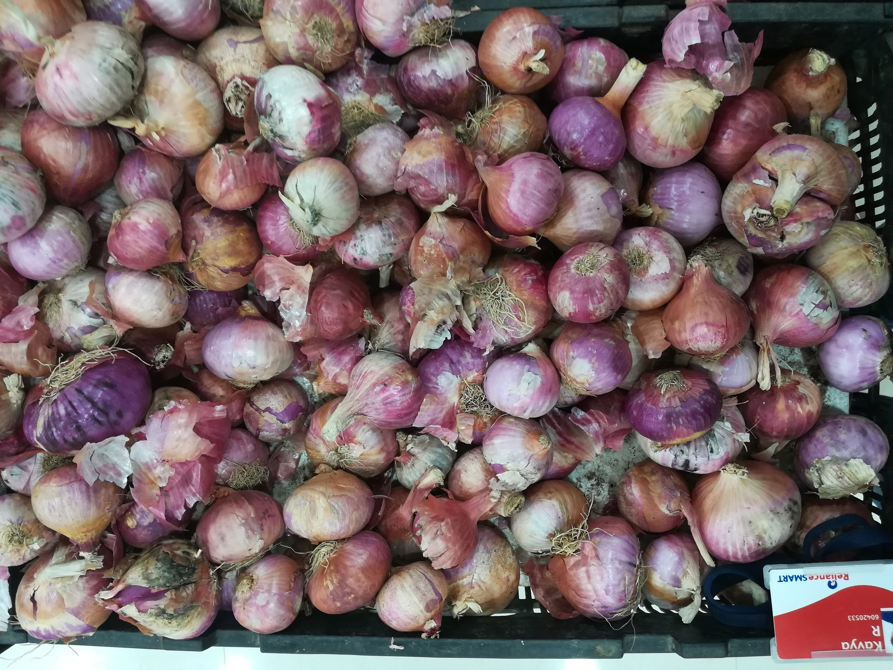
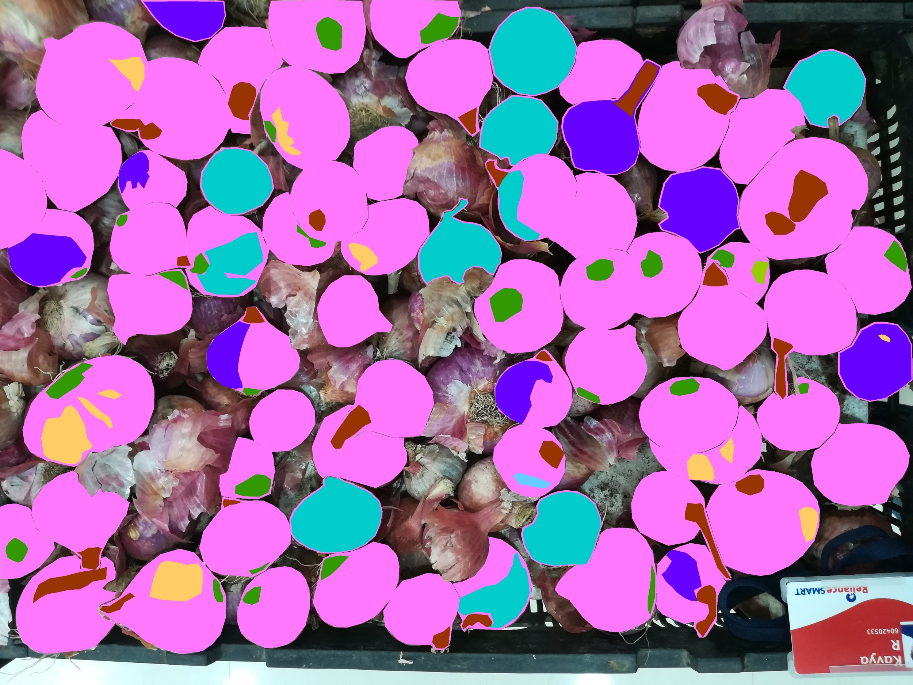
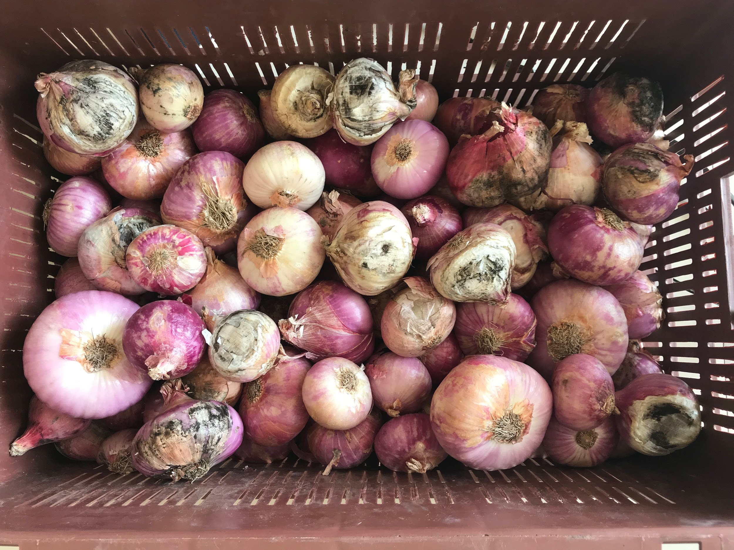
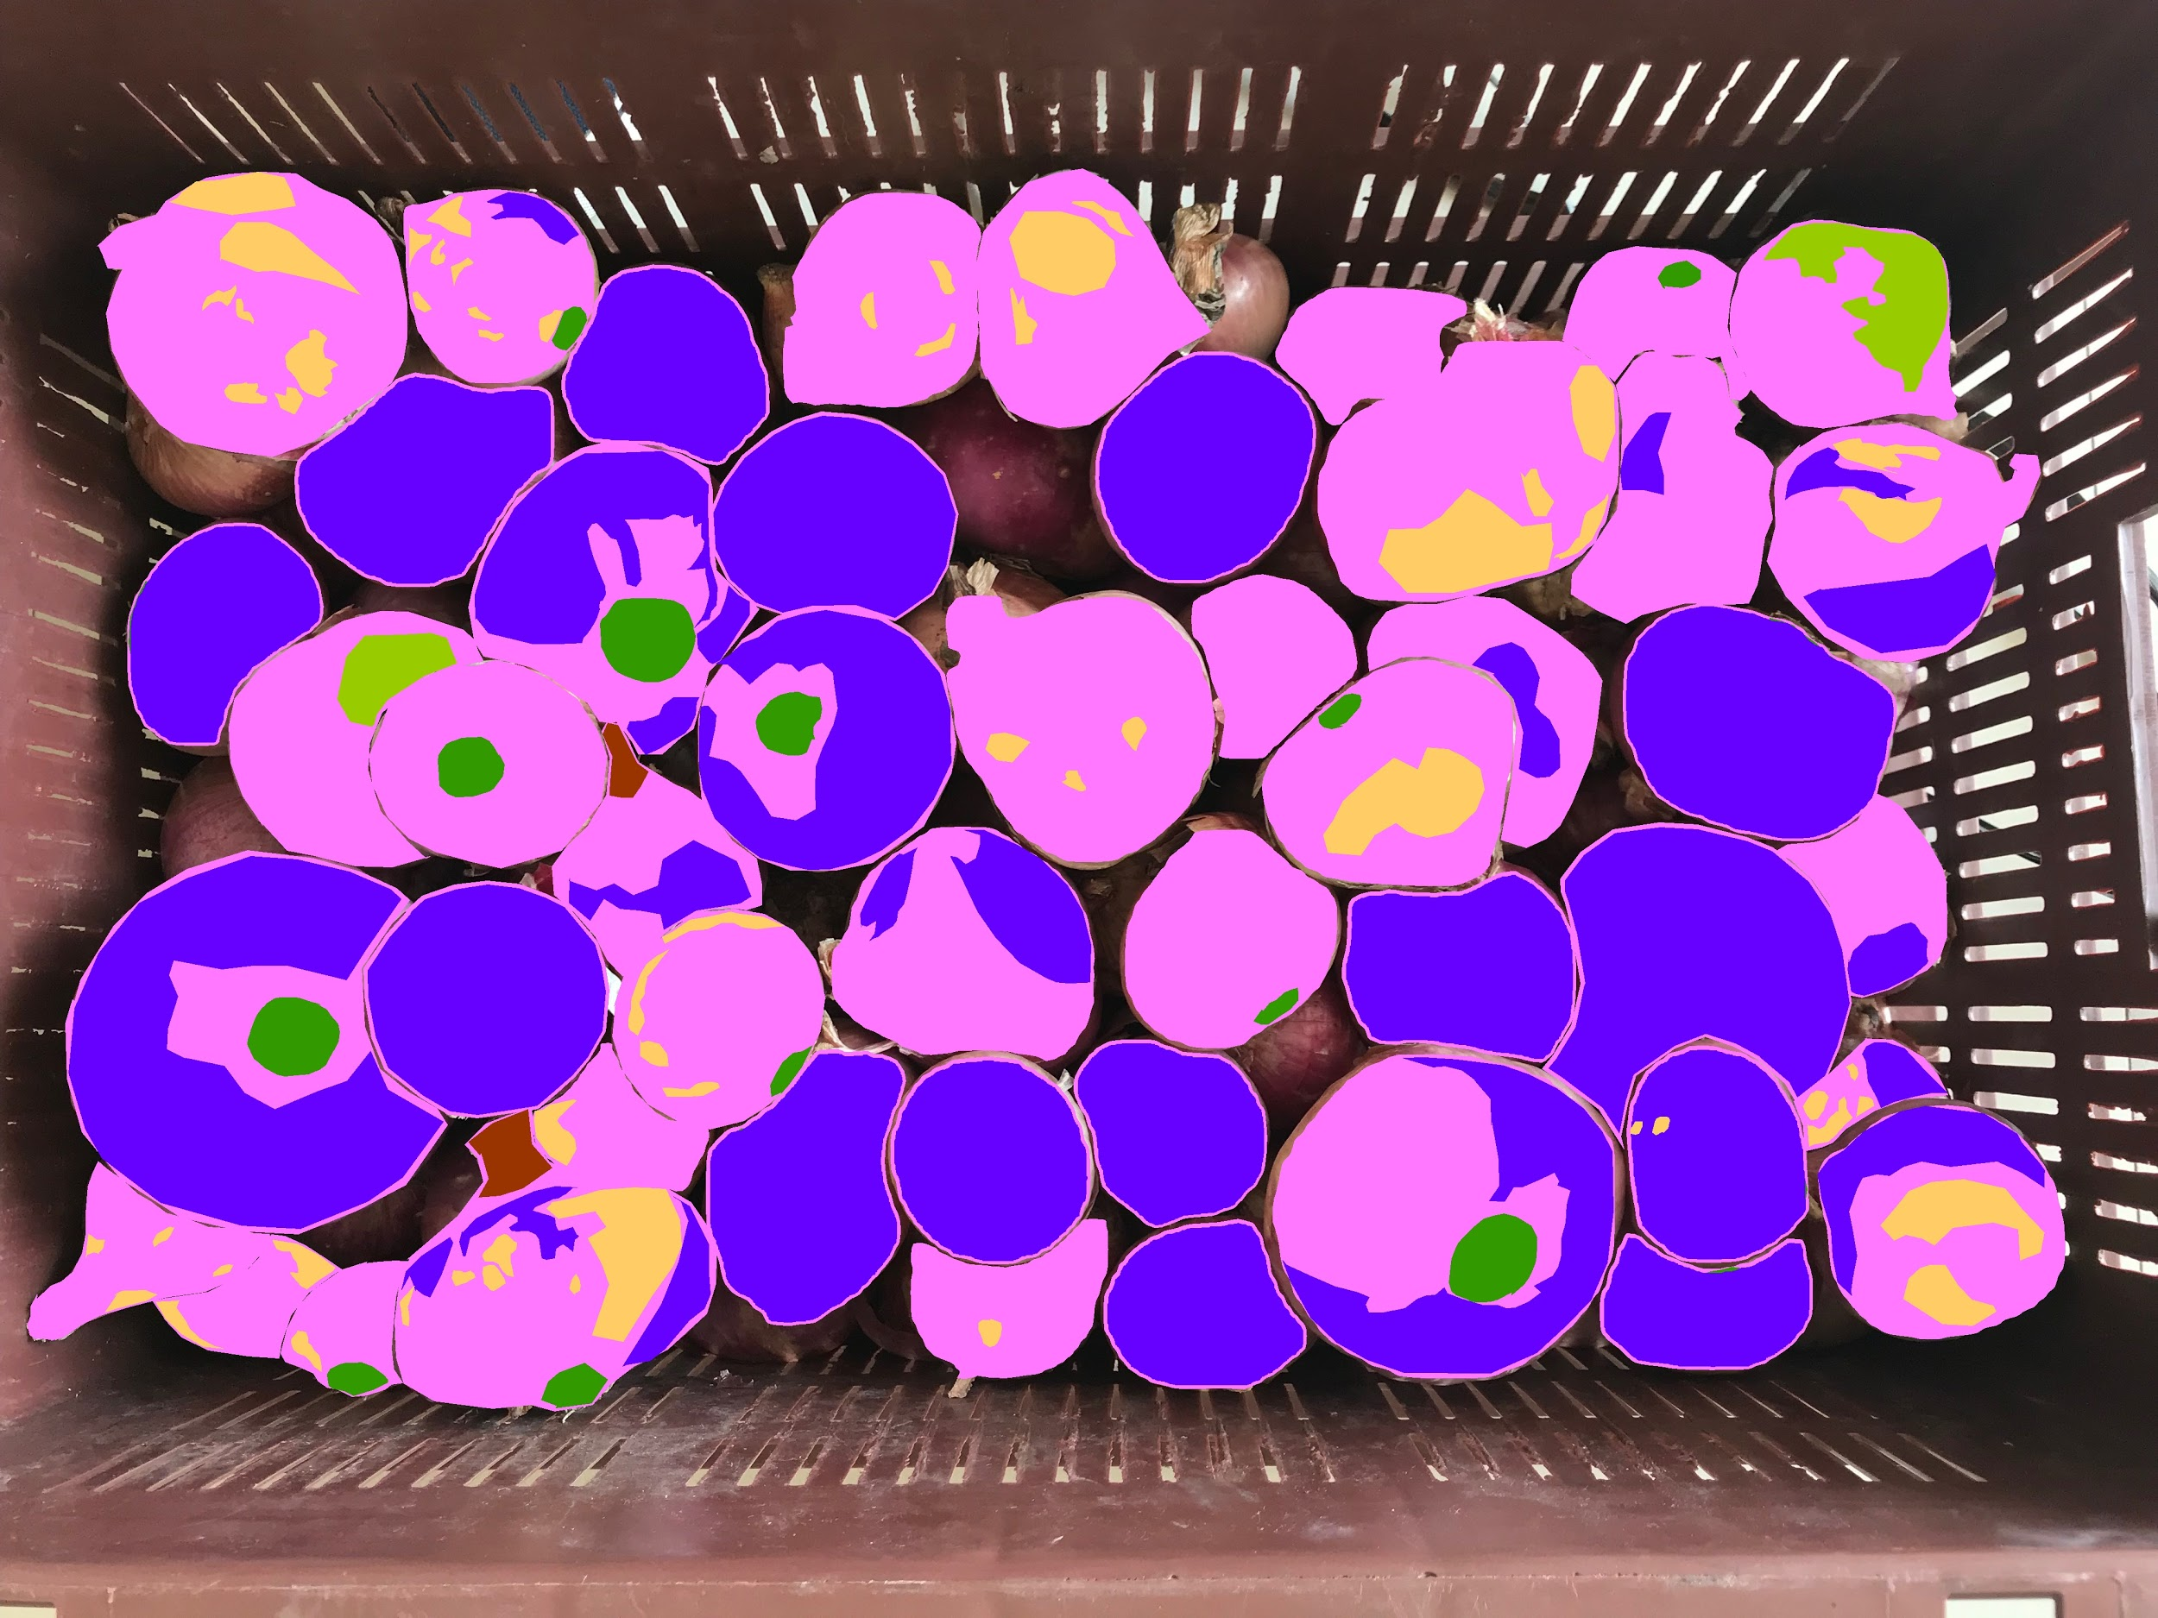
Data Preprocessing (Sample)
<Grading of Onion in Real Time>
Raw Images
Processed Images

Slide 9
STATE OF THE ART
<Grading of Onion in Real Time>
Implemented Solution:
We implemented a unet architecture with a resnet 152 encoder because it is exhibits a high IOU score with limited data. We would like to experiment with Mobilenet going forward when we have more data at hand.
Used Machine Learning Algorithms/Network/ framework:
We have implemented our model in Tensorflow framework.
While current state of the art segmentation models aren’t based on neural networks, we have tried to utilize CNNs to solve this problem

Slide 10
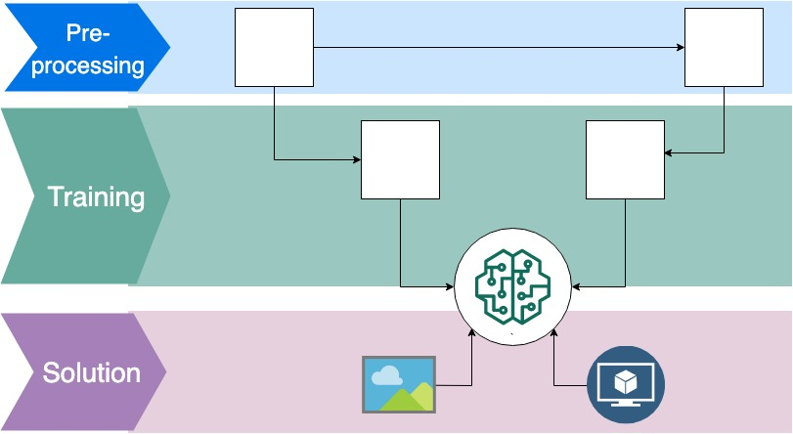
Workflow Overview
<Grading of Onion in Real Time>
Original Image
Masked Image
Input Image
Output Image
Converted to
256 X 256 X 3
Converted to
256 X 256 X 3
Using UNet ML algorithm
Model
Input Image
Segmentation Results

Slide 11
EXPERIMENTAL EVALUATION
<Grading of Onion in Real Time>
Accuracy, performance and running time : Inference Time : (1.1 sec on GPU) , Performance : 30 Million parameters.
While we initially ran into technical errors while running our model on the cluster (Resource exhaust error), we were able to achieve the training accuracy and validation accuracy as 72% and 73% respectively by utilizing gpu partially.
We compared the models and evaluated the performance using IOU (Intersection over Union) & Inference Time and IOU and DICE score, respectively.

Slide 12
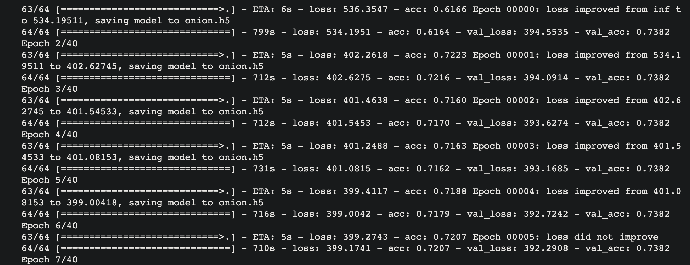
Model Training Process

Slide 13
HOW TO REPRODUCE THE RESULT
<Grading of Onion in Real Time>
1. For generating masked images using json annotations, please refer to ExplorationwithLoop.ipynb in src/
2. For model definition & training please refer to AI_HACK.ipynb in src/
3. Our trained model (onion.h5) lies in model/
4. In order to run the UI, please run $python server.py
Demonstration Video: https://drive.google.com/drive/u/1/folders/1tmKxvryMQzGtE74y62voga593txQ0CyV

Slide 14
FUTURE DIRECTIONS
<Grading of Onion in Real Time>
Right now we have created only RGB (3 channeled images) as masked outputs for training. For the next stage, we would definitely create n_classes ( 10 here) channeled images, which we feel would train better.
In future work, we would oversample the ‘sun burn’ class because it is underrepresented in the data set. For further tests, we would copy the image
Model: We would explore different segmentation architectures such as FCN & PSPNet
UI/UX: Take in video input for real time segmentation of various types of onions in a vegetable distribution facility.

